Slide 1


Collaborative Internal Job Portal

Slide 2
Collaborative Internal Job Portal
GraphicDen
Developer Team :
Smily (1410991607)
Sidharth Sriram (1410991588)
Simran Kaur (1410991596)
Sivcan Singh (1410991606)

Slide 3
Collaborative Internal Job Portal
Project Statement
A website (GraphicDen now in developed form) which has the front-end that offers a form and takes the details from the user and also uploading a database file (.csv format support).
The back-end will be generating a graph based on the entered database with strong analytic strategy using Javascript (D3) Library.

Slide 4
Collaborative Internal Job Portal
Technology Used
Front End
HTML
CSS
JavaScript
D3.JS Library
JSON
Back End
Django WebFramework
Postgres Database (v9.5)

Slide 5
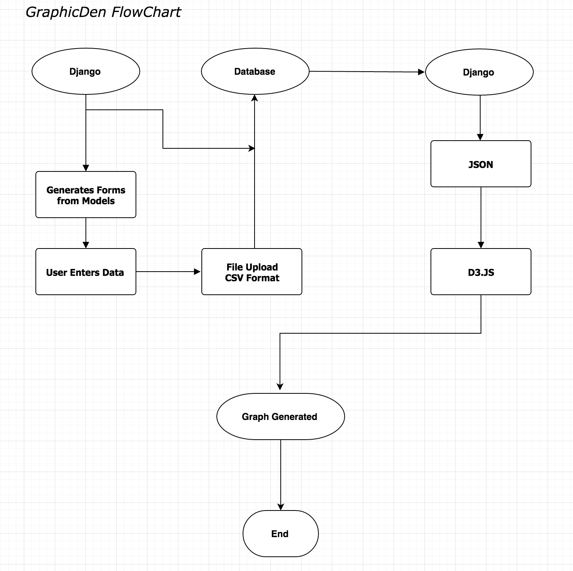
Collaborative Internal Job Portal

Slide 6
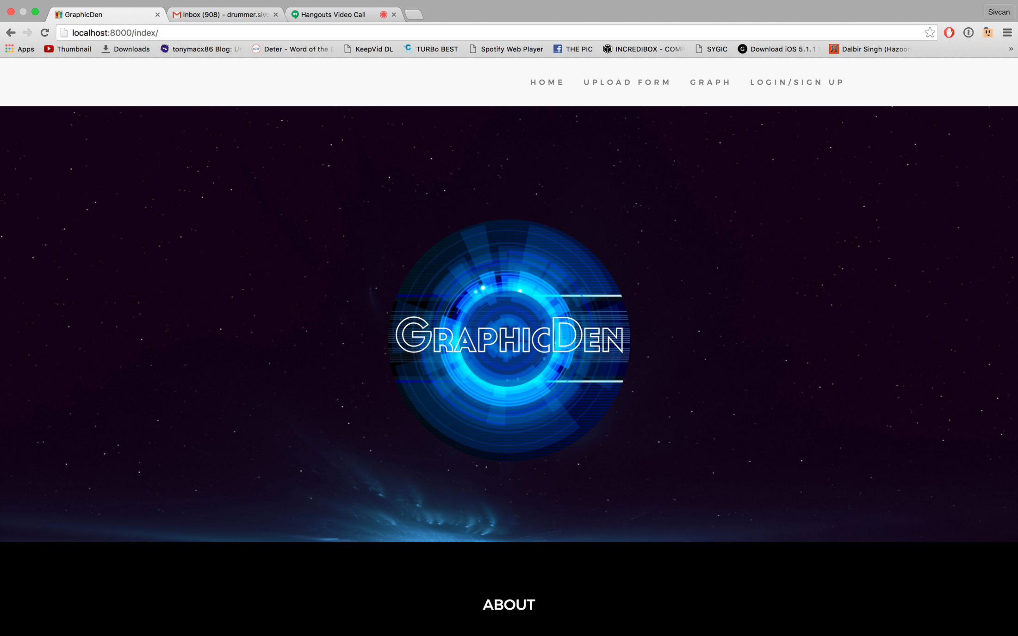
Collaborative Internal Job Portal
Flow Diagram

Slide 7
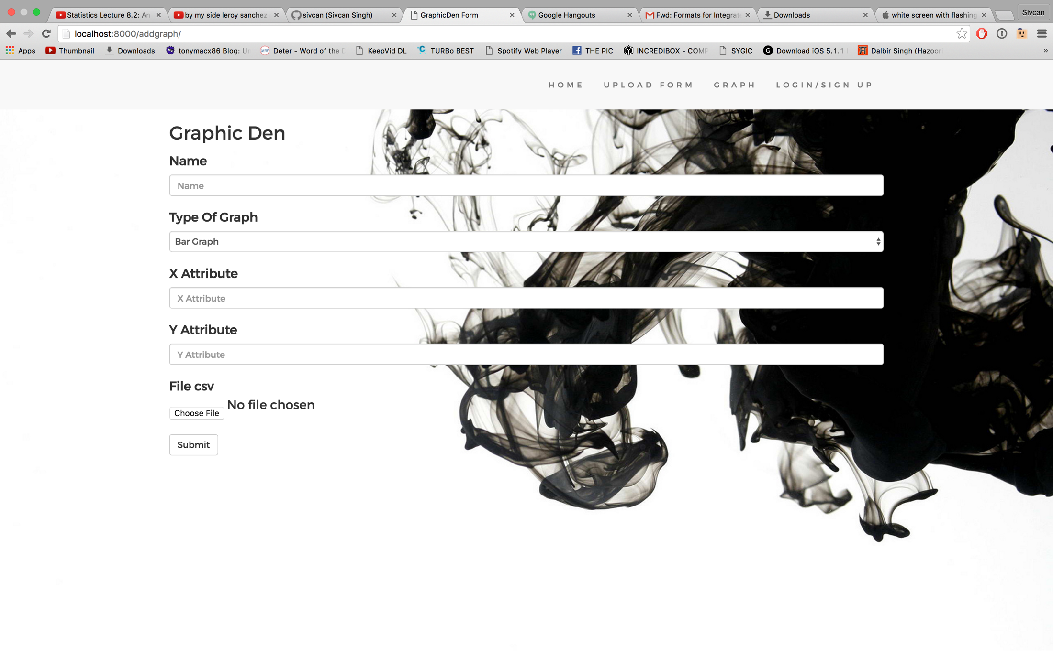
Collaborative Internal Job Portal
Flow Diagram

Slide 8
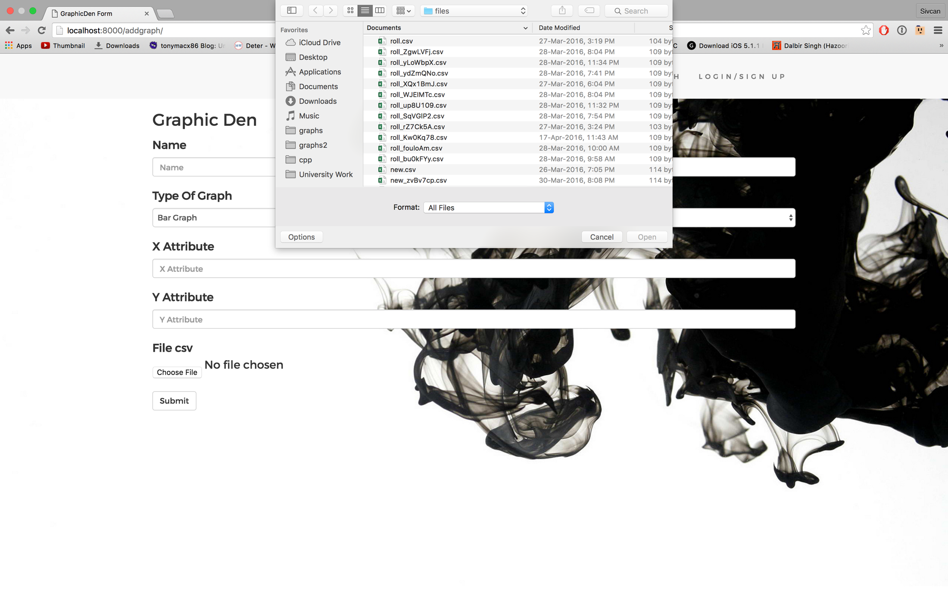
Collaborative Internal Job Portal
Flow Diagram

Slide 9
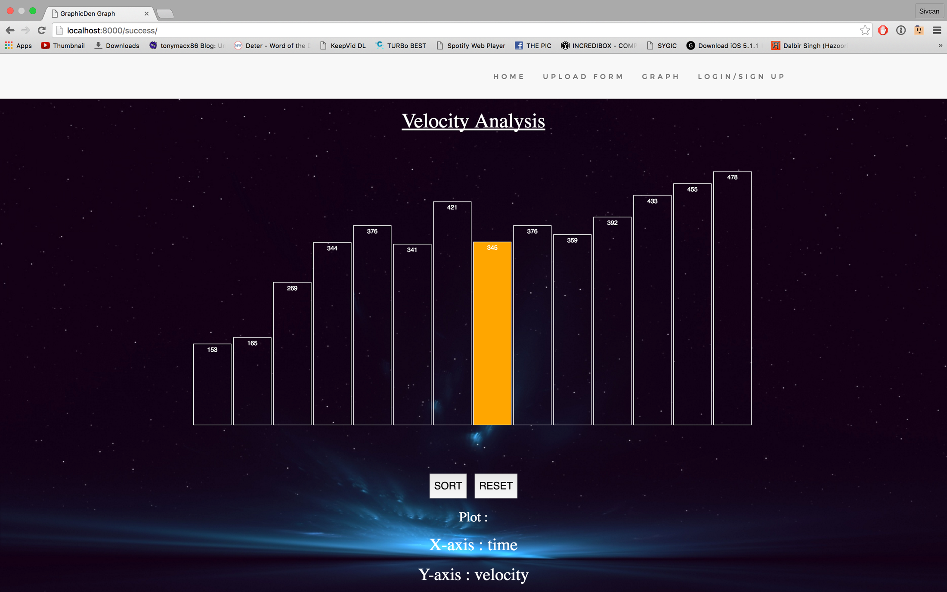
Collaborative Internal Job Portal
Snapshots

Slide 10
Collaborative Internal Job Portal
Future Scope
Data Scientists will use it for statistical analysis.
University and School professors will use it for analysis of students result.
Business Giants will use it to analyze their net profit.
Researches and Scientists will use it to plot rate and other scientific measurement.
Medical Society will use it to keep a check of their patient’s health.

